Slide 1
Distributed and Cloud Computing
K. Hwang, G. Fox and J. Dongarra
Chapter 4: Cloud Platform Architecture over Virtualized Datacenters
(suggested for use in 5 lectures in 250 minutes)
Prepared by Kai Hwang
University of Southern California
April 3, 2012

Slide 2
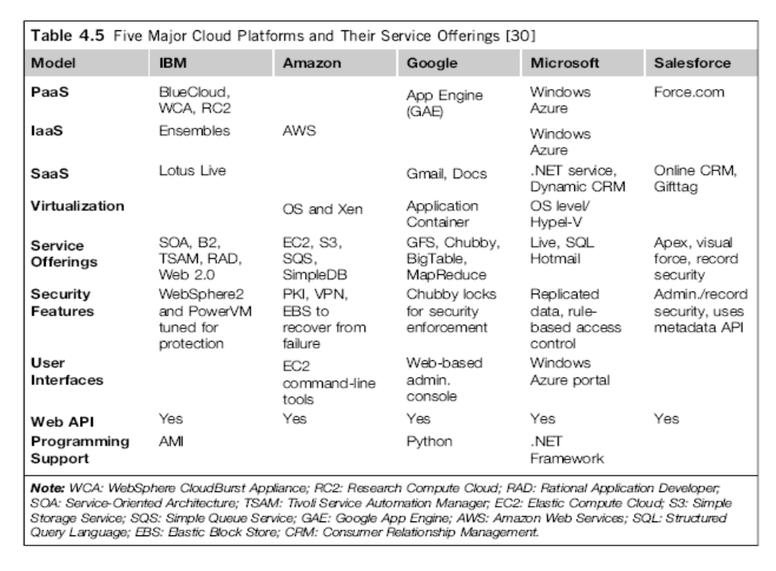

Slide 3
Platform as a Service (PaaS): Google App Engine
This platform allows users to develop and host web application in Google
datacenters with automatic scaling according to the demand.
It is a free service for a certain limit and it only requires a Gmail account to
access the services. After the free limit is exceeded the customers are
charged for additional storage, bandwidth and instance hours.
The current version supports Java, Python and Go as the programming
languages and Google plans to add more languages in the future.
All billed App Engine applications have a 99.95% uptime SLA. App Engine is
designed to sustain multiple datacenter outages without any downtime.
The app engine has a few restrictions - can only execute code called from
an HTTP request, Java applications may only use a subset from the JRE( Java Runtime Environment) standard edition and Java application cannot create new threads.

Slide 4
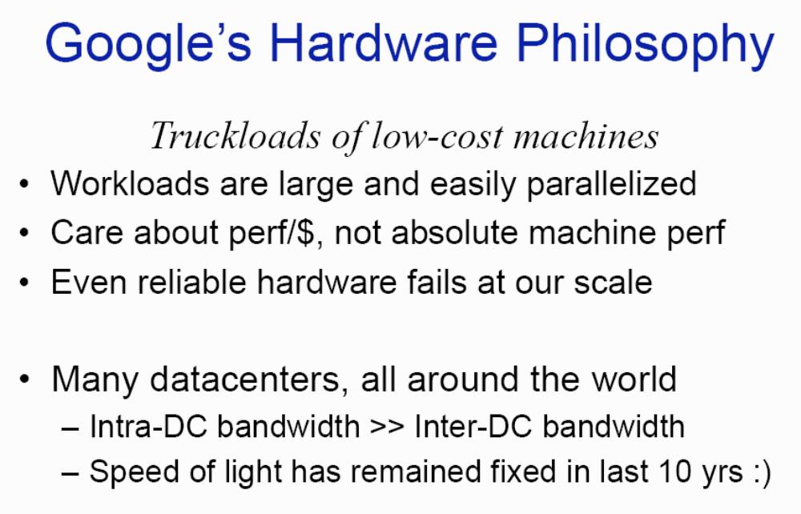
(Courtesy of Jeffrey Dean, 2008)
Notes:
Cloud applications are the key global opportunity for developers during next four years
2009: $8.5 billion
2013: $16.8 billion

Slide 5
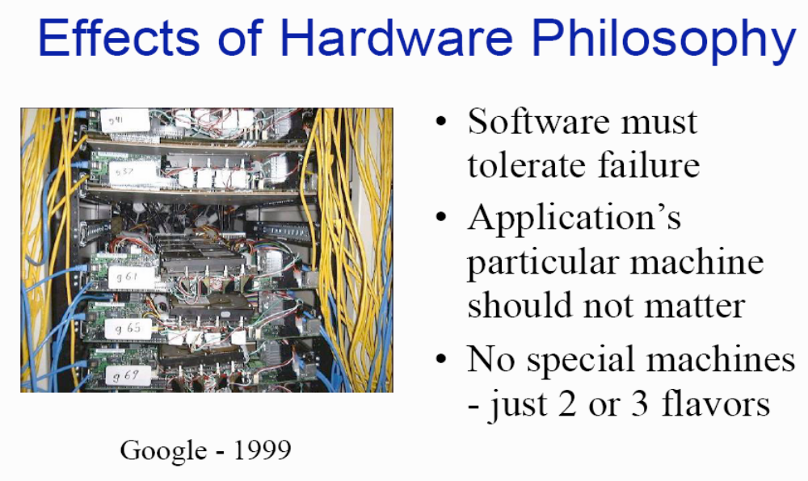
(Courtesy of Jeffrey Dean, 2008)
Notes:
Cloud applications are the key global opportunity for developers during next four years
2009: $8.5 billion
2013: $16.8 billion

Slide 6
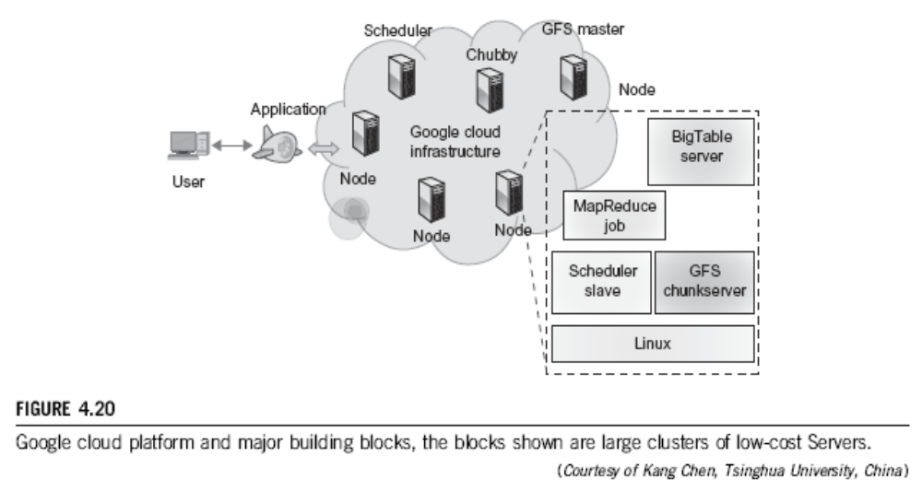
Google AppEgine (GAE)

Slide 7
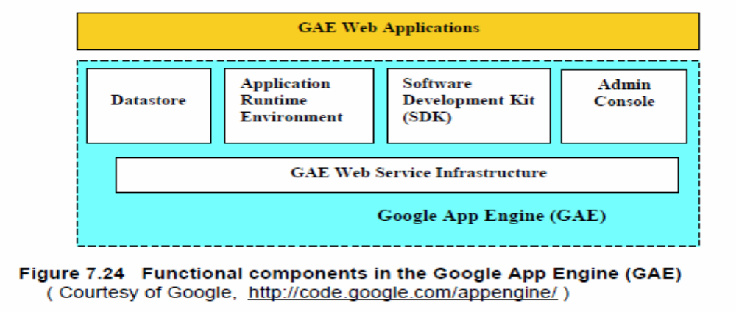
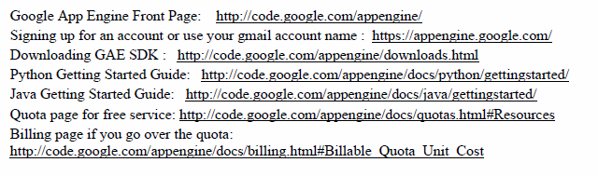

Slide 8
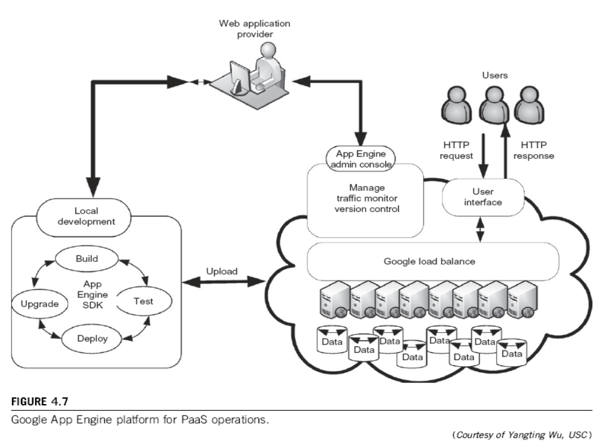

Slide 9
AWS – a leader in providing public IaaS services.
EC2 (Elastic compute cloud allows users to rent virtual computers to run their own computer applications. It allows scalable deployment. A user can create, launch, and terminate server instances as needed, paying by the hour for active servers.
S3 (simple storage service) provides the object-oriented storage service for users.
Objects are accessed via SOAP (Simple Object Access Protocol)
EBS (Elastic block service) provides the block storage interface which can be used to support traditional applications.
Amazon DevPay is a simple to use online billing and account management service that makes it easy for businesses .

Slide 10
AWS – a leader in providing public IaaS services. (cont’d)
MPI clusters uses hardware-assisted virtualization instead of para-virtualization and users are free to create a new AMIs (Application Messaging Interfaces)
AWS import/export allows one to ship large volumes of data to and from EC2 by shipping physical discs.
Brokering systems offer a model for controlling sensors and providing office support of smartphones and tablets. Service broker is a distributed layer of software that orchestrates many of the normal activities of a wireless sensor and control network.
Small-business companies can put their business on the Amazon cloud platform.
Using AWS they can service a large number of internet users and make profits through those paid services.

Slide 11
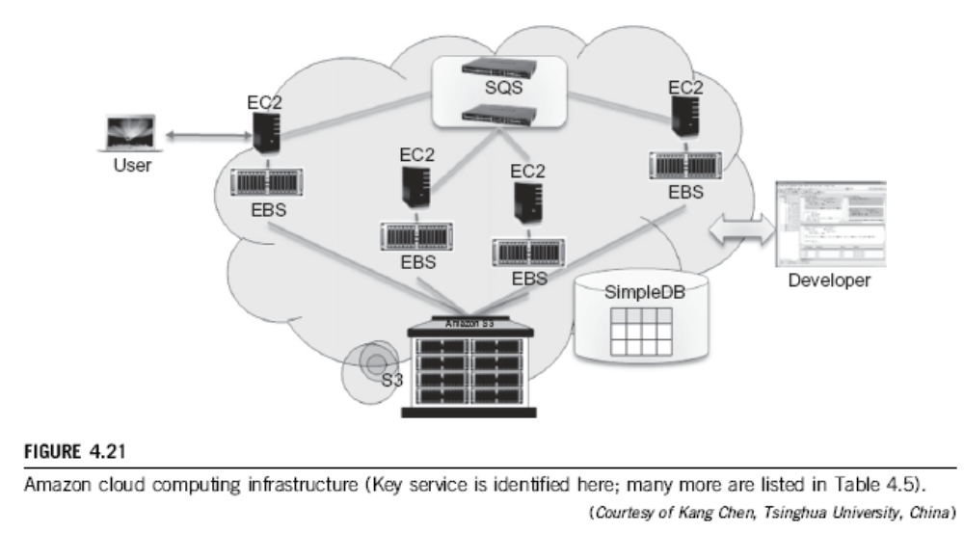
Amazon Web Services (AWS)

Slide 12
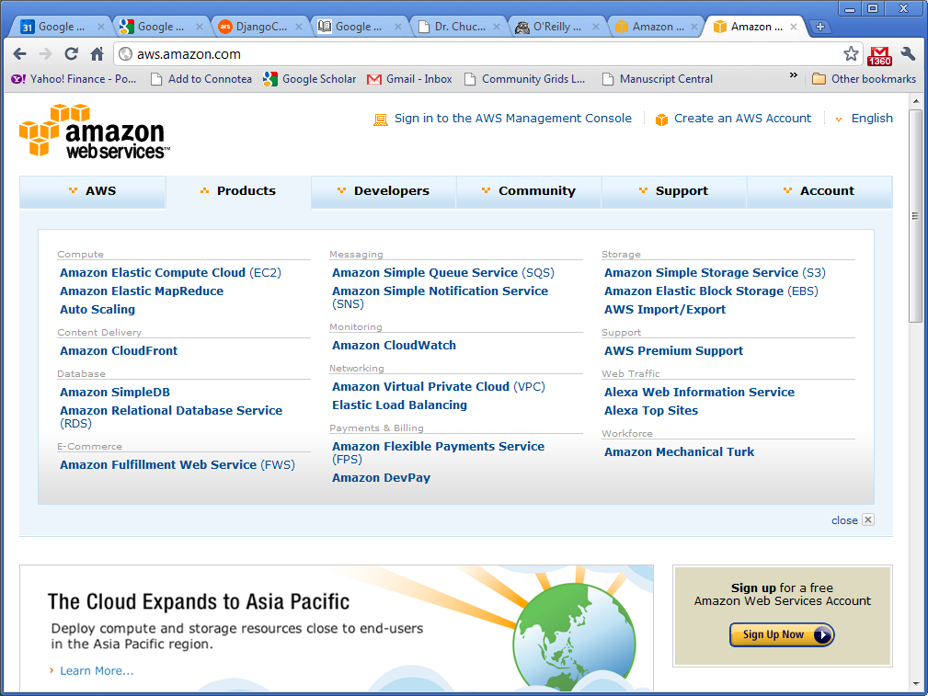
Amazon Web Services (AWS)

Slide 13
Microsoft Azure Cloud :
This is essentially a PaaS Cloud.
Windows Azure run its cluster hosted at Microsoft's datacenters that manages computing and storage resources. One can download Azure development kit to run a local version of Azure. It allows Azure applications to be developed and debugged on the windows 7 hosts.
All cloud services can interact with traditional MS software applications such as Windows Live, Office Live, Exchange Online, etc.
If offers a Windows-based cloud platform using Microsoft virtualization technology. Applications are built on VM’s deployed on the data-center services. Azure manages all servers, storage and network resources of the data center.

Slide 14
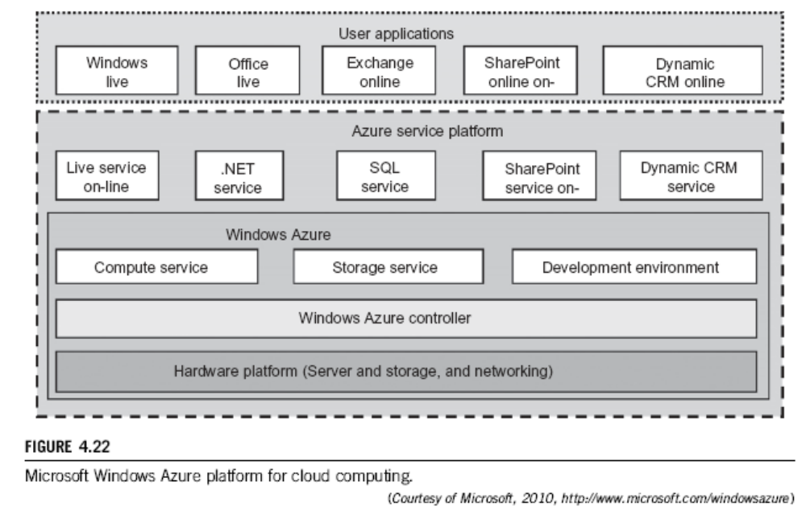
Microsoft Windows Azure

Slide 15
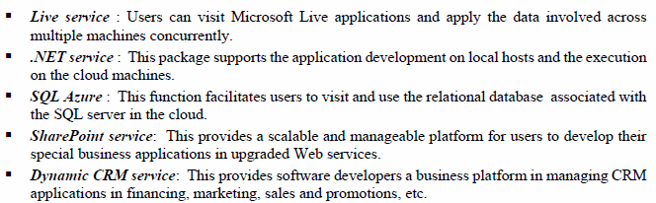
Microsoft Windows Azure

Slide 16
Collocation Services(LaaS) : Savvis
The company sells managed hosting and collocation services with 50 data centers (approximately 1.54 million square feet) in North America, Europe, and Asia, automated management and provisioning systems, and information technology consulting.
It provides collocation services -- provides services to house, power and secure all the physical and network resources of a data center. It also provides managed hosting, a type of Internet hosting in which the client leases an entire server not shared with anyone.

Slide 17
Network Cloud Services(NaaS) : AT&T
AT&T has a flexible and scalable suite of on-demand cloud which offers a cost-saving alternative to many conventional hosting services. Its robust portfolio of mobile apps, voice, and data services can be delivered as a total cloud solution under security protection.
AT&T has a good track record of serving corporate and government clients and enterprise hosting clients. It has security capabilities that are embedded and integrated into the core of its network, with physical and network authentication, firewall management, intrusion detection and protection, denial of service mitigation, and encryption capabilities.
One can buy access to cloud computing and cloud storage using AT&T services. With up to 99.99 percent availability and the enterprise-class security of AT&T Internet Data Centers, they can provide the performance and network bandwidth needed for most demanding cloud solutions.

Slide 18
Virtualization Services (HaaS) : Vmware
VMware provides virtualization software with a market share more than 80%. The company was acquired by EMC in 2004 for $625 million.
VMware Workstation: This software suite allows users to run multiple instances of x86 or x86-64 -compatible OS on a single physical PC.
VMware Fusion: This provides similar functionality like the VMware Workstation for users of the Intel Mac platform, along with full compatibility with virtual machines created by other VMware products.
VMware Server: It is provided as freeware for non-commercial use, and it is possible to create virtual machines with it. It is a "hosted" application, which runs within an existing Linux or Windows operating system.
VMware ESX : It is an enterprise-level product, can deliver greater performance than the freeware VMware Server, due to lower system overhead. VMware ESX is a "bare-metal" product, running directly on the server hardware, allowing virtual servers to also use hardware more or less directly.
VMware vSphere is a "cloud OS" capable of managing large pools of infrastructure, including software and hardware from networks.

Slide 19
Buisness Models Salesforce.com :
Salesforce.com's CRM solution is broken down into several cloud service models: Sales Cloud, Service Cloud, Data Cloud (Jigsaw), Collaboration Cloud ( Chatter) and Custom Cloud (Force.com). (I) Sales Cloud : A SaaS provider allows user to access anywhere through an Internet-connected mobile device or computer. The service include real-time sales collaborative tool called Chatter, provides sales representatives with a complete customer profile and account history, manages marketing campaign spending, tracks all opportunity-related data including milestones, decision makers, customer communications, etc. Automatic email reminders are scheduled to keep teams up to date on the latest information. (II) Service Cloud : The Service Cloud provides companies with a call center-like view that enables companies to create and track cases coming in from every channel, and automatically route and escalate what’s important. The Salesforce CRM-powered customer portal provides customers the ability to track their own cases 24 hours a day.(III) Force.com platform : Salesforce.com's PaaS platform allows external developers to create add-on applications that integrate into the main salesforce.com application and are hosted on salesforce.com's infrastructure.

Slide 20
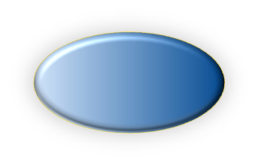
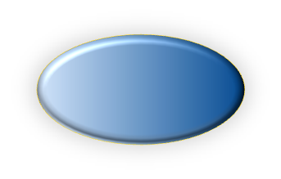



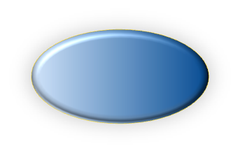
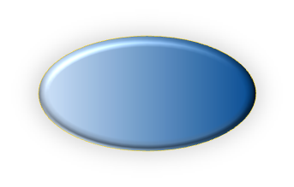
Autonomic Cloud Management
Develop methodologies and tools to automate the
process of cloud management in 4 objectives
3. Manage energy
consumption
under SLA
constraints
1. Manage resources
to provisioning of
service quality
assurance and
adaptation
Resource Management
Power Management
Autonomic Cloud Management
Capacity Management
Load Balancing
4. Develop fault
prediction
models for
proactive failure
management
2. Automate the
configuration
process of VMs
and virtual
clusters
Admission Control
Reliability Management
Notes:
Funded by U.S. NSF grants: CNS-1016969, CNS-0914330, CNS-0851856, CRI-0708232, CNS-0702488, CCF-0611750, DMS-0624849
Sun Center of Excellent in
Open Computing Sys and
Applications (OSCA)

Slide 21
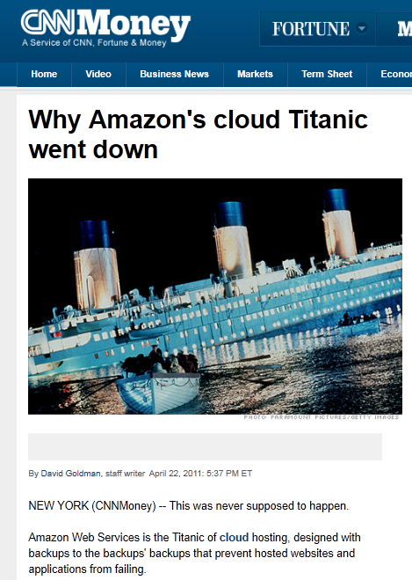
Amazon’s Lesson
Down for 3 days since 4/22/2011
1000x of businesses went offline. E.g. Pfizer, Netflix, Quora, Foursquare,Reddit
SLA contract
  99.95% availability (<4.5hour down）
  10% penalty, otherwise
Notes:
SLA = Service Level Agreement

Slide 22
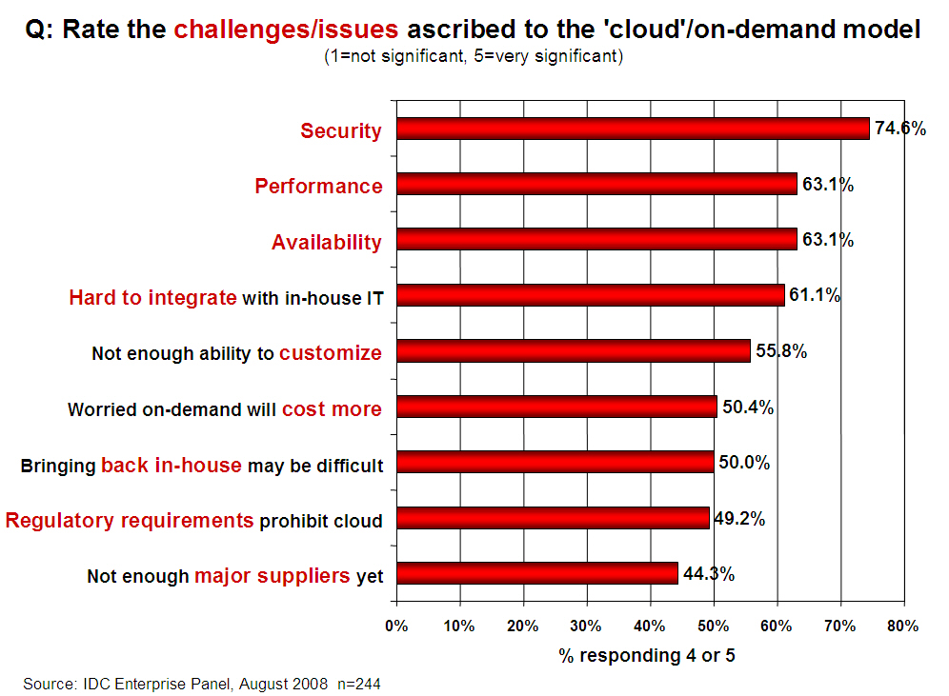
Challenges/Issues in Cloud Computing

Slide 23
Energy-Efficiency in Google Gmail Services
http://www.google.com/green/pdfs/_x000b_google-green-computing.pdf
Clouds win by energy-efficient resource use over datacenters
Business Type | No. of users | No. of servers | IT Power per user | PUE (Power Usage effectiveness) | Total Power per user | Annual Energy per user
Small | 50 | 2 | 8W | 2.5 | 20W | 175 kWh
Medium | 500 | 2 | 1.8W | 1.8 | 3.2W | 28.4 kWh
Large | 10000 | 12 | 0.54W | 1.6 | 0.9W | 7.6 kWh
Gmail (Cloud) | ∞ | ∞ | < 0.22W | 1.16 | < 0.25W | < 2.2 kWh

Slide 24
